Slide 1
Tracking Detector
Manuel Dorian Tuor, Mariano Fasano, Felix Huber, Florian Hellwig

Slide 2
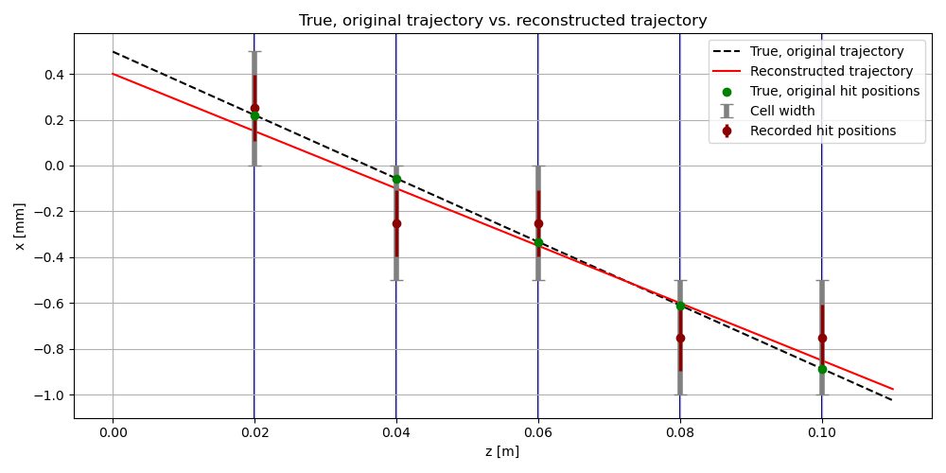
Single trajectory
Std deviation of correct cell marked

Slide 3
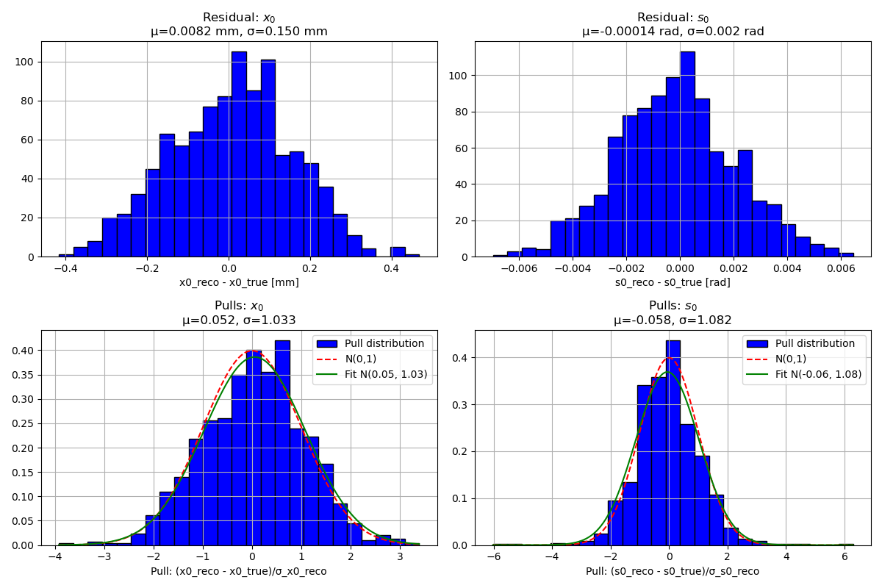
Multiple trajectories
Std deviation of the slope -> nonlinearity resulting in underestimation of the error

Slide 4
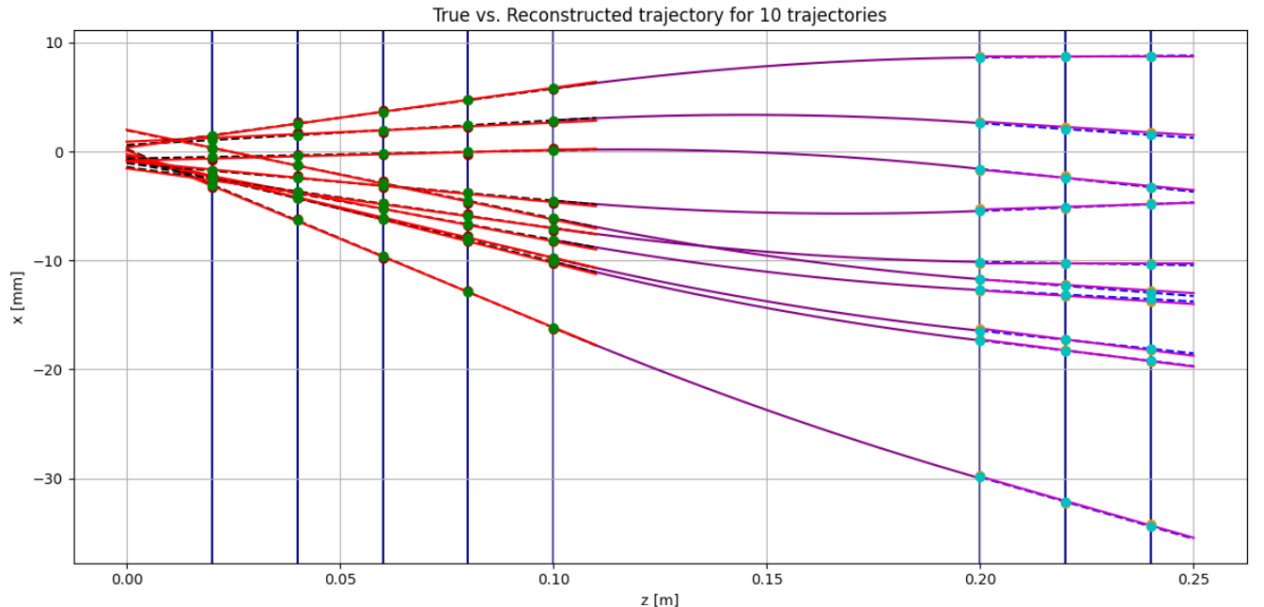
Momentum resolution
Multiple trajectories

